Slide 1
Overview of the Russian River Watershed Association
May 18, 2017
Andy Rodgers, Executive Director
Mark Landman, Chair of the Board of Directors
Mark Millan, Vice Chair

Slide 2
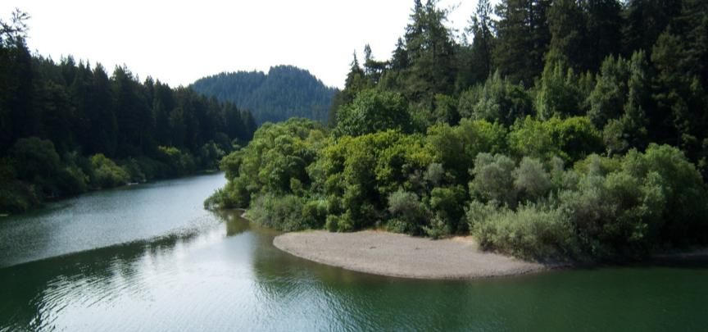
A coalition of eleven cities, counties and special districts in the Russian River Watershed that have come together to coordinate regional programs for
clean water,
habitat restoration
and watershed enhancement.

Slide 3
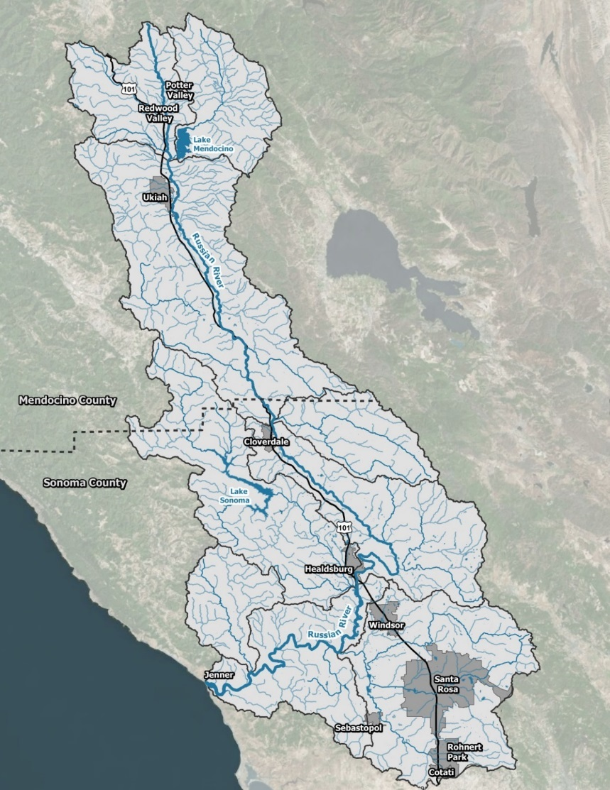
Members
County of Sonoma
County of Mendocino
Cloverdale
Cotati
Healdsburg
Rohnert Park
Santa Rosa
Sebastopol
Ukiah
Windsor
Sonoma County Water Agency

Slide 4
Presentation Outline
RRWA Overview
Watershed Facts
RRWA’s Role in the Watershed
RRWA Structure
RRWA Programs

Slide 5
RRWA Overview

Slide 6
Watershed Facts
1,500 square miles of forests, agricultural lands and urban lands in Mendocino and Sonoma Counties
Two major reservoirs
Russian River flows 110 miles from its headwaters near Redwood Valley and Potter Valley to the Pacific Ocean near Jenner
Home to approximately 360,000 people
238 streams and creeks, and 63 species of fish

Slide 7
RRWA’s Role in the Watershed
RRWA exists to serve the interests of our member agencies
RRWA meetings are open to the public
RRWA partners with other groups in the watershed

Slide 8
Individual
Citizens
Regional
Partners
Regulatory
Agencies
Local
Non-profits

Slide 9
RRWA Structure
Governance: Board of Directors
Member elected officials and managers
Working Group: Technical Working Groups
Member agency staff
Admin / Executive Support: Executive Director
RRWA staff
Fiscal Agent: City of Ukiah
Budget – 100% from member agencies
Annual Work Plan: Executive Director Services,
General Benefit Projects,
Special Benefit Projects

Slide 10
RRWA Programs
MS4 Permit Compliance Support
Outreach
Monthly Environmental Articles
Social Media and Website
High School Video Contest
Safe Medicine Disposal
Russian River Friendly Landscape Guidelines
Low Impact Development Training
Grant Funding (Storm Water Resource Plan)

Slide 11
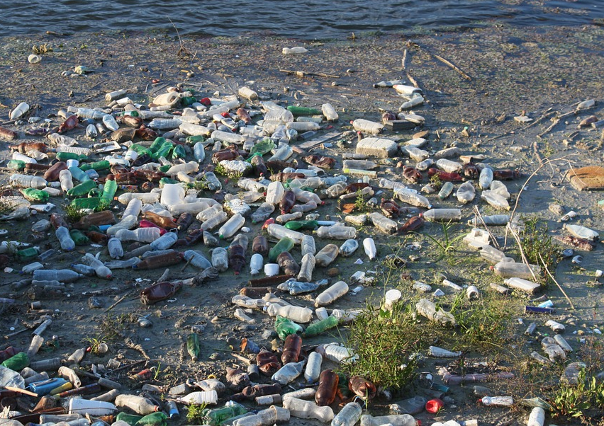
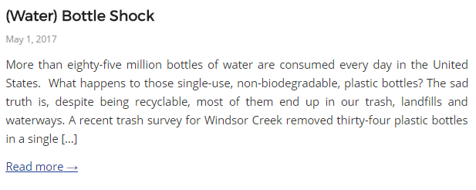
Environmental Articles
RRWA publishes monthly articles on numerous stewardship topics in order to raise awareness of our water resources. Look for the monthly articles in local newspapers and on the RRWA Blog.
Articles published monthly in English and Spanish on the RRWA Blog and local newspapers

Slide 12
Social Media
Website and Social Media update
Facebook, Instagram, and YouTube channels launched in August 2016
The goals of RRWA Social Media program are to increase awareness of RRWA and traffic on the RRWA website

Slide 13
Social Media
Like, Comment, Follow, and Share!
https://www.facebook.com/RRWatershed
@russianriverwatershed
http://www.rrwatershed.org/
Notes:
Month of May
Theme: Water Awareness + High School Video Contest
If folks would like to advertise certain events, they can use RRWA’s social media

Slide 14
High School Student Videos
Annual High School Video Contest with the Sonoma County Water Agency
2017 Topic: “Ditch the Plastic Your Water is Fantastic”

Slide 15
Safe Medicine Disposal Program
Jointly operated by RRWA and local agencies since 2003
Over 110k pounds of medications have been collected from the residents of Sonoma and Mendocino County
Program provides safe disposal bins for unwanted medications, which helps prevent overdoses and protects the environment
Drop-off locations are available throughout the watershed

Slide 16
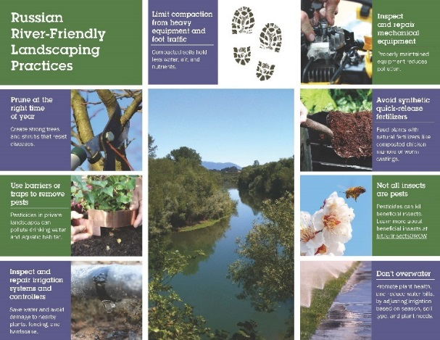
Russian River-Friendly Landscape Guidelines
RRWA developed seven landscaping principles to help landscape professionals design, create and maintain landscapes that support the integrity of the waterways
Maintenance mini-guide and residential flyer now available on www.rrwatershed.org/project/russian-river-friendly-landscape-guidelines/

Slide 17
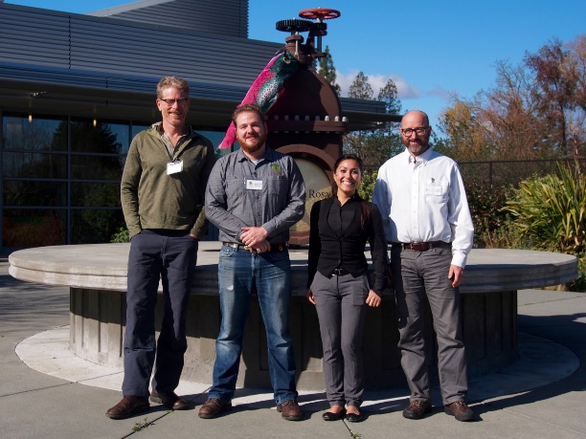
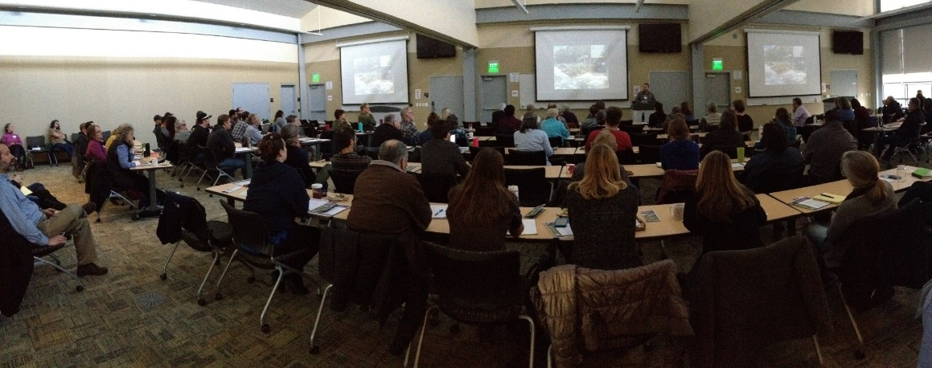
Russian River-Friendly Landscape Guidelines
Event for Landscape Professionals: January 24
120 registrants + 5 from wait list
From precipitation to percolation, each speaker focused on different aspects of storm water in landscaping

Slide 18
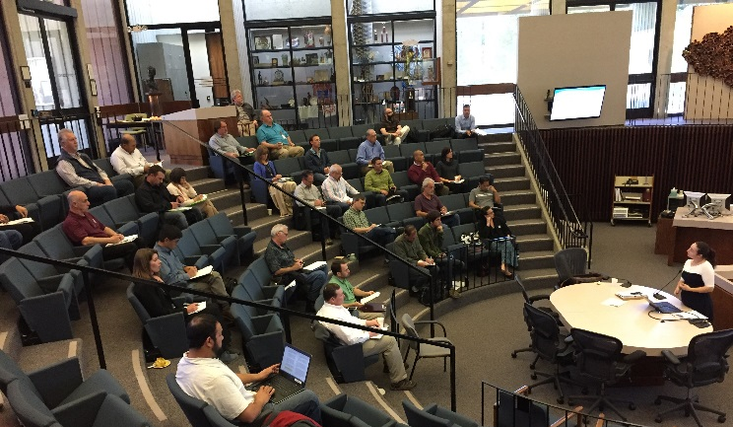
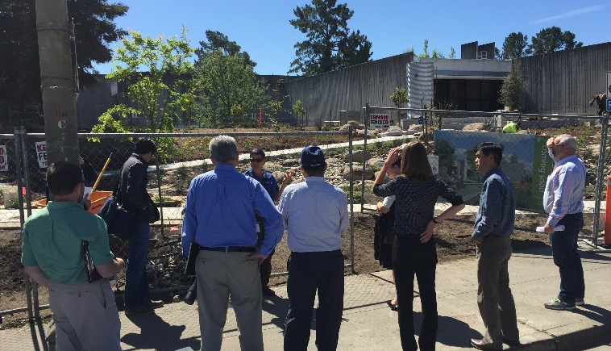
Low Impact Development (LID) Trainings
LID trainings held April 3 and 24
Provided introduction to LID, an overview of changes to the LID Technical Design Manual, and the timing for new requirements
Tour of Santa Rosa’s Sustainable Education Garden

Slide 19
Storm Water Program
RRWA Supporting Member Agencies with
Laguna Mark West Monitoring and Reporting Work Plan
Trash Assessment Report
Ethnic Community Outreach Work Plan
Outreach campaigns
Permit compliance activities summary tables

Slide 20
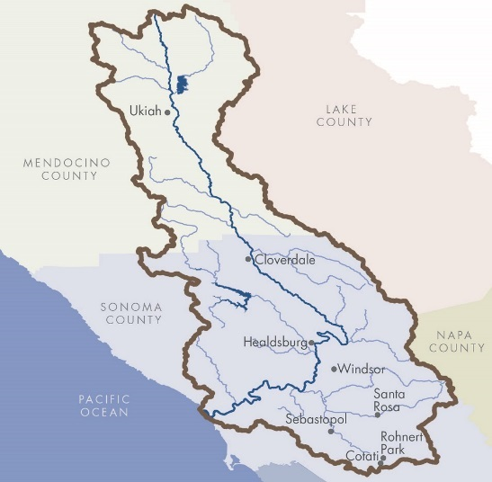
Prop 1 Storm Water Resource Plan (SWRP)
Overview of the SWRP Grant
$500,000 grant awarded to Ukiah on behalf of the RRWA
$1.2M total effort, including local match efforts
Goal of the SWRP is to identify projects that capture and re-use storm water runoff to provide multiple benefits

Slide 21
Prop 1 Storm Water Resource Plan (SWRP)
RRWA Member Agencies
Twenty-four collaborating entities, including
North Coast Regional Water Quality Control Board
North Coast Resources Partnership (North Coast IRWM)
San Francisco Estuary Institute
Sonoma County Agricultural Preservation and Open Space District
Sonoma Resource Conservation District
Gold Ridge Resource Conservation District
Mendocino Resource Conservation District
Sonoma Land Trust
Pepperwood Preserve
Lawrence Berkeley National Laboratory
Laguna de Santa Rosa Foundation
National Oceanic and Atmospheric Administration
Mendocino County Russian River Flood Control & Water Conservation Improvement District

Slide 22
Prop 1 Storm Water Resource Plan (SWRP)
Benefits of the regional approach
RRWA has a track record of working together successfully
Leverage collective resources and expertise
Regional projects reduce individual costs
Allows for larger projects, greater benefits, and increased likelihood of implementation funding

Slide 23
Russian River Regional Monitoring Program (R3MP)
NCRWQCB discretionary funding grant
San Francisco Estuary Institute (SFEI) facilitating development of R3MP
The R3MP’s goal is to develop a coordinated, standardized, cost effective monitoring program that collects data and communicates information about surface water quality in the Russian River Watershed for the purpose of addressing management questions driven by regulatory goals and objectives

Slide 24
Russian River Regional Monitoring Program (R3MP)
The R3MP will initially focus on surface water monitoring within the Russian River Watershed to benefit the current Municipal Separate Storm Sewer System (MS4) co-permittees under their watershed-based National Pollutant Discharge Elimination System (NPDES) permit. The benefits will include better:
access to monitoring data and results;
public reporting of monitoring reports;
understanding of the effects of coordinated storm water management on water quality throughout the watershed;
science to adjust the permit and management practices to improve their performance.

Slide 25
New Programs in FY 17-18
Maintain Core Programs
MS4 Permit Compliance Support
Storm Water Resource Plan (SWRP)
Russian River Regional Monitoring Plan (R3MP)
Seek New Grant Funding
Expand Membership

Slide 26
Contact US
Website: www.rrwatershed.org
Email: Info@rrwatershed.org
Phone: 707-508-3670
Mailing Addresses: Mendocino County
300 Seminary Avenue
Ukiah, CA 95482
https://www.facebook.com/RRWatershed
@russianriverwatershed
http://www.rrwatershed.org/

